Slide 1




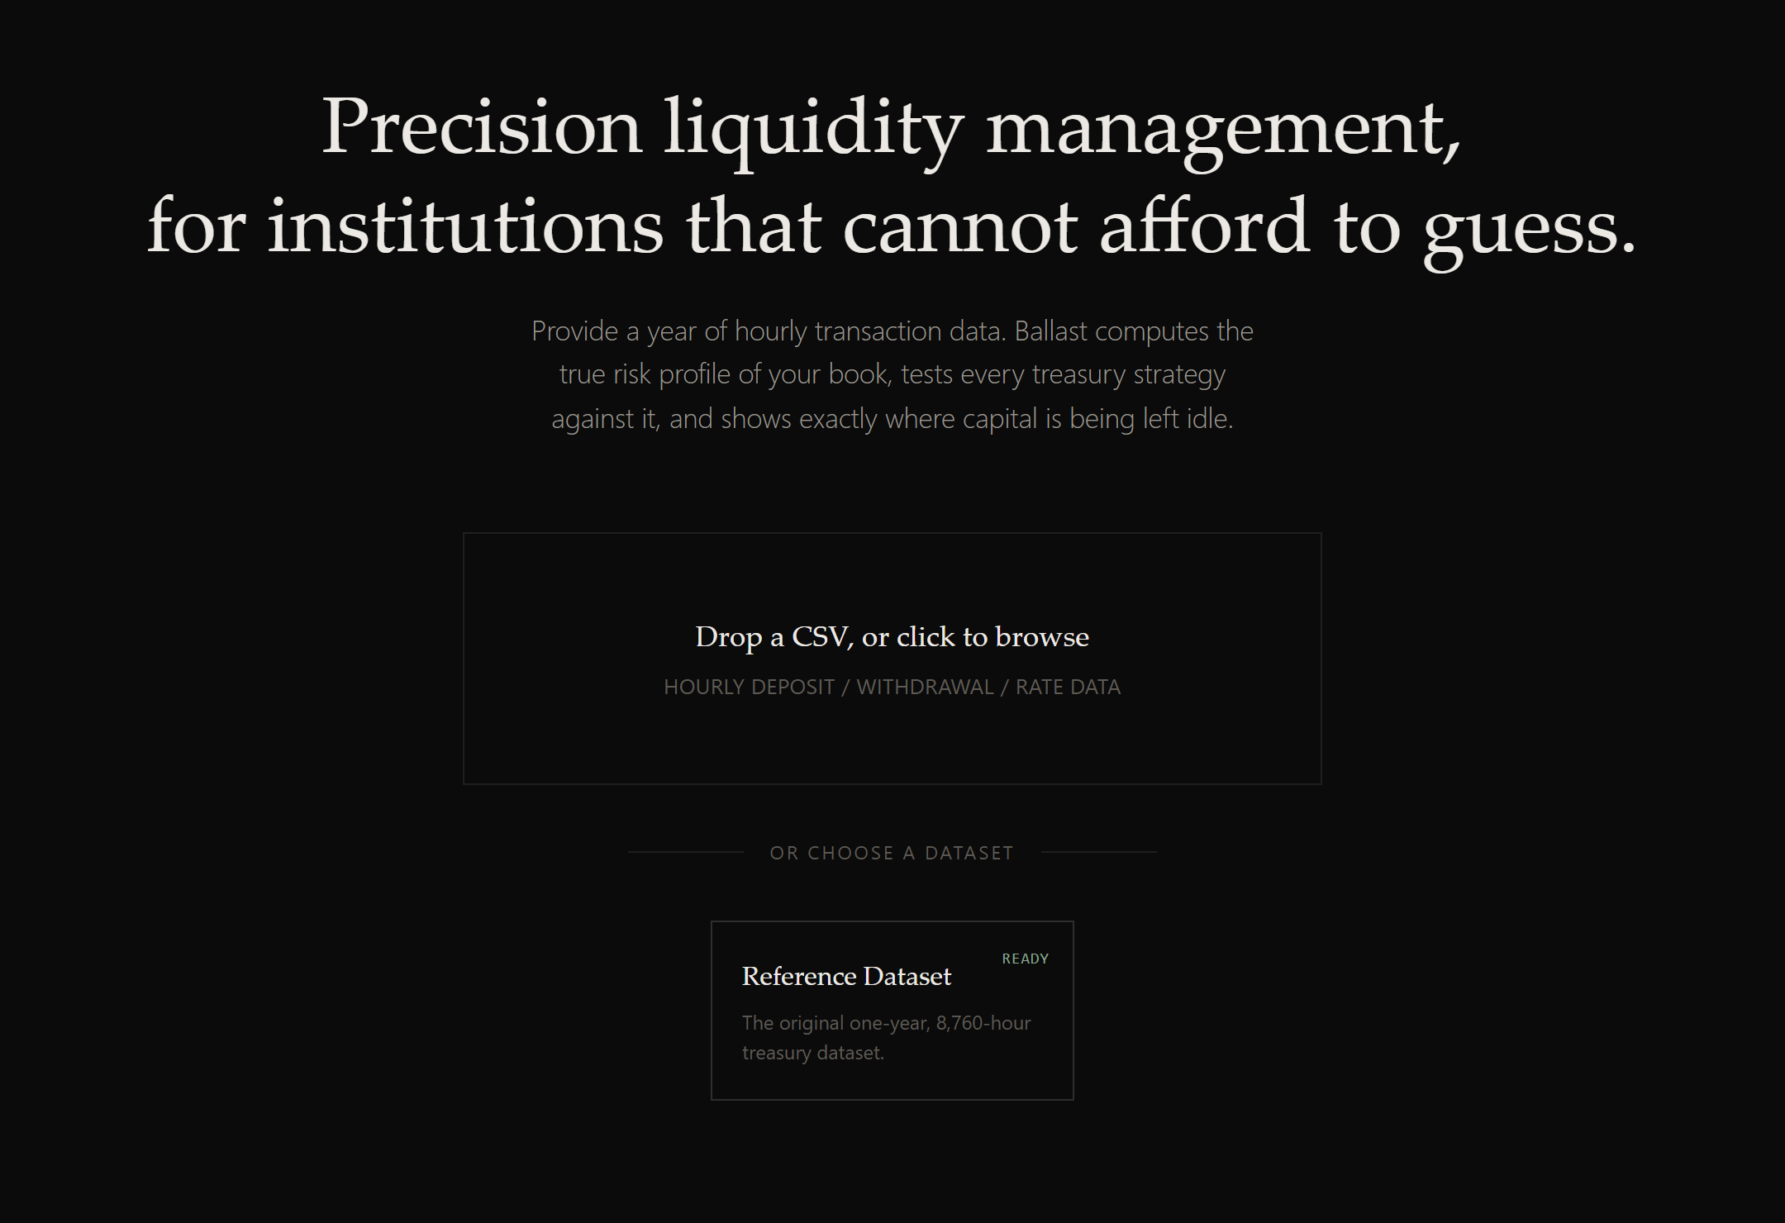
HACKFORGE '26 • ADVANCED TRACK
BALLAST
The Reserve Juggler: Autonomous Treasury Engine
An autonomous, risk-calibrated treasury autopilot that guarantees 100% of customer payouts without delay while eliminating millions in idle cash drag through dynamic day-of-week sweep optimization.
PROBLEM STATEMENT
TEAM NAME
The Idle Cash Problem: The Reserve Juggler
globalhost
LIVE DEPLOYMENT
AUTHOR & ROLE
https://ballast.jkartik.in
Kartik Jain (jkartik.in)
Jugal Marwah
Rudra Galia
PAYOUT SUCCESS
NET COST SAVINGS
REPLAY LATENCY
100.0%
$20.98M
5.72s
Zero customer delays
50.8% reduction vs cash
8,760 hours vectorized
Notes:
Good morning judges. We are team globalhost, and we present Ballast — an autonomous, risk-calibrated treasury liquidity engine built for The Reserve Juggler challenge. Digital platforms process over $20 million per hour in gross deposits and withdrawals. Holding cash in checking accounts yields zero percent, while locking money into overnight repo accounts subjects the bank to severe early-redemption break penalties. Ballast solves this fundamental tension: maintaining 100% payout reliability while cutting liquidity costs by over 50%, proven across 8,760 hours of real transaction data. Our production platform is live at ballast.jkartik.in.

Slide 2
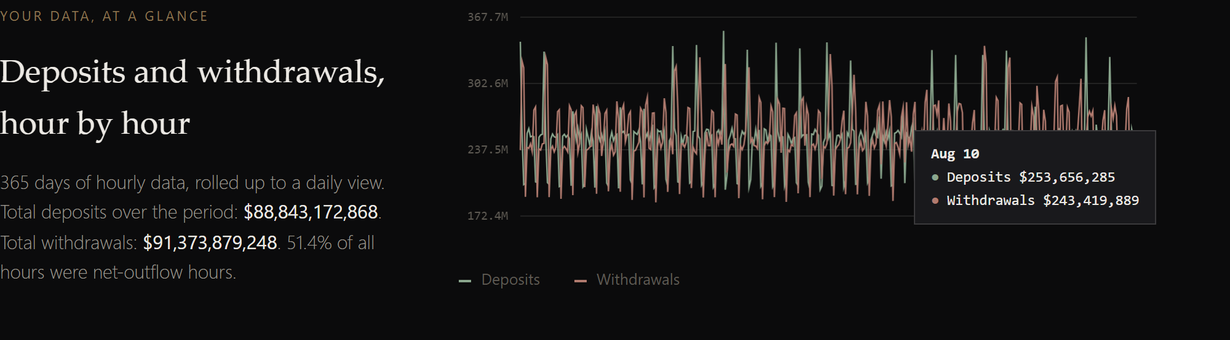
SLIDE 2 : PROBLEM FRAMING
THE $20M/HOUR ASYMMETRY: CASH BUFFER VS. YIELD VAULT
Holding too much cash bleeds millions in lost interest; holding too little triggers a 292% APR break fee penalty.
THE LIQUIDITY TRADE-OFF
VELOCITY & ASYMMETRY IN THE DATA
OBJECTIVE & FAILURE MODES
The Cash Buffer (Tier 0):
0% yield. Provides immediate withdrawal liquidity. But holding excess cash caused $34.4M in foregone interest in the benchmark book.
Extreme Flow Velocity:
$20,000,000 gross hourly volume ($10.1M deposits / $10.4M withdrawals). Small estimation errors compound at multi-million scale.
The Mathematical Objective Function:
Min Total Cost of Liquidity = Foregone Idle Yield + Tier Break Penalties + Overdraft Interest + Liquidation Haircuts across 8,760 hours.
The Yield Vault (Tier 1 Repo):
~4.30%–5.00% APY. Locked strictly overnight from 17:00 to 08:00 next morning (a 15-hour illiquidity window).
Structural Outflow Drift:
Hourly net flow is negative 51.4% of the entire year. Cumulative net flow drifts down -$2.53B, steadily draining starting capital.
Hard Solvency Invariant:
Payout Success Rate = 100.0%. Every customer withdrawal and merchant settlement must be funded without delay or rejection.
The 292% APR Break Fee Trap:
Early redemption triggers a flat 0.50% penalty on principal. For a 15-hour freeze, that equals 292% annualized APR! One single break erases months of accumulated interest.
Day-of-Week Volatility Spike:
Friday & Saturday overnight net drains average $27.8M and $31.7M (peaking at $46.7M) — over 4.5x larger than Wednesday ($5.9M)!
Failure Mode 1: The Naive Sweeper:
Fixed % of gross or moving-average models ignore the 15h path accumulation, triggering dozens of emergency tier liquidations.
The Overdraft Trap:
Relying on emergency credit facilities costs 18% APR and signals regulatory distress. Overdraft cannot be a cost optimization strategy.
Why Simple Rules Fail:
A static buffer either leaves $14M+ idle on calm weekdays, or triggers repeated weekend defaults. Static buffers cannot adapt to regime asymmetry.
Failure Mode 2: Overdraft Trapped Bank:
Treating overdraft as cheap credit leads to capital depletion. Ballast enforces overdraft as a hard waterfall barrier of last resort.
TRANSACTION VELOCITY AT A GLANCE (LIVE BENCHMARK)
Over 8,760 hours, the bank processed $88.8B in total deposits and $91.4B in total withdrawals — an annual net outflow of -$2.53B. The green line shows daily deposits fluctuating between $190M–$280M, while red withdrawals surge during paydays and holidays. Ballast ingests this raw series directly and protects against intraday drawdowns without look-ahead bias.
BALLAST // Autonomous Treasury Engine
HackForge '26 Advanced Track • Problem: The Reserve Juggler
Team globalhost | ballast.jkartik.in
Notes:
Slide 2 frames the delicate financial physics. When managing $20 million per hour, treasury cash management faces a steep asymmetry. Breaking Tier 1 overnight repo incurs a flat 50 basis point penalty. For a 15-hour overnight lockup, that is an annualized rate of 292%. If you hold too much cash, you bleed interest; if you hold too little, one early break destroys months of yield. Worse, our audit of the data revealed that overnight drain is not uniform: Friday and Saturday nights experience up to 5 times the worst-case drain of a Wednesday night. A static buffer either burns $14M in idle cash on weekdays or triggers weekend defaults. Ballast addresses this exact dynamic.

Slide 3
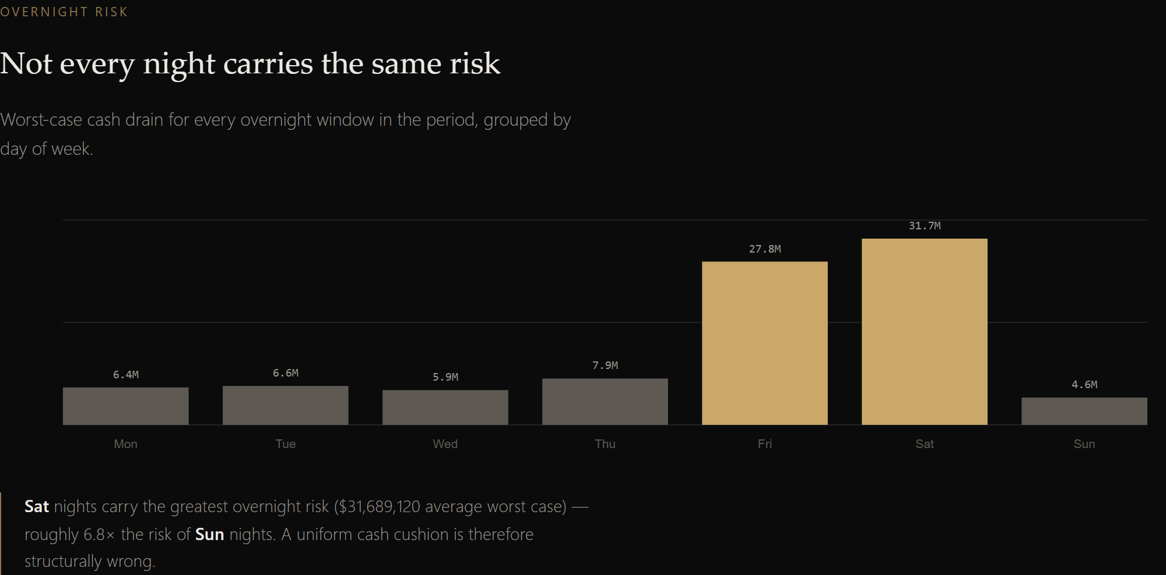
SLIDE 3 : MODEL AND ALGORITHM
PATH-MAX NEWSVENDOR FORMULATION & 5-TIER WATERFALL
Why hourly variance models fail, how the 98.6% critical fractile is derived, and our cost-ordered liquidity hierarchy.
THE QUANTITATIVE ARCHITECTURE
1. The Path-Max Risk Formulation (M_t):
Standard models size for hourly standard deviation or end-of-day balances. This fails because liquidity breaks happen at the intraday trough. Ballast defines risk as the maximum cumulative net drawdown across the 15-hour overnight window (17:00 to 08:00):
M_t = max_{tau in [17:00, 08:00]} sum_{s=17}^{tau} (-net_flow_s)
If Tier 0 cash entering 17:00 >= M_t, zero early breaks can occur.
2. Asymmetric Newsvendor Fractile (q*):
We balance the cost of under-buffering (C_under = 0.50% break fee) against over-buffering (C_over = 15/8760 * 4.30% = 0.00736% foregone repo carry). The critical fractile equation gives:
q* = C_under / (C_under + C_over) = 0.0050 / (0.0050 + 0.0000736) = 98.63%
The optimal cash buffer is the 98.63th empirical quantile of M_t.
3. Day-of-Week Regime Conditioning:
Because M_t on weekends averages 4.5x higher than weekdays, Ballast conditions the empirical quantile on the calendar regime:
• Weekdays (Sun–Thu): Buffer target ~ $15.0M
• Weekends (Fri–Sat): Buffer target ~ $41.3M
At 17:00, Ballast sweeps exactly: Sweep = max(0, Cash_Available - Buffer).
THE COST-ORDERED FUNDING WATERFALL
Tier 0: Operating Cash (0.0% APY) — Fee: 0 bps fee
Instant buffer, absorbs normal intraday transactions
Tier 1: Overnight Repo (4.30% APY) — Fee: 50 bps penalty
Primary yield engine, locked 17:00–08:00 (broken only under surge)
4. Structural No Look-Ahead Enforcement:
A decision at hour t may use only information strictly available before t. Enforced by construction through a Python HistoryView accessor that physically slices index < t. Verified by mutation unit tests that prove zero future data leakage.
Tier 2: Treasury Bonds (4.75% Yield) — Fee: 200 bps haircut
Strategic core liquidity (tested & disabled by default — see Slide 7)
Tier 3: Strategic Equity (10.0% Return) — Fee: 1,500 bps haircut
Surplus buffer, locked against emergency liquidation
Emergency Credit Line (N/A) — Fee: 18.0% APR
Overdraft facility of last resort, strictly post-waterfall
BALLAST // Autonomous Treasury Engine
HackForge '26 Advanced Track • Problem: The Reserve Juggler
Team globalhost | ballast.jkartik.in
Notes:
On Slide 3, we detail our quantitative foundation. Conventional treasury systems look at average hourly flow or end-of-day balances. That is a dangerous mistake: if you drain $20M at 2 AM and receive $20M at 7 AM, your terminal balance is zero, but you broke the bank at 2 AM. We formulate the risk variable as Path-Max M — the maximum cumulative net outflow across the entire 15-hour freeze. Next, we solve the asymmetric newsvendor equation. Because breaking repo costs 50 bps while holding idle cash costs only 0.74 bps overnight, the critical fractile is 98.63%. Sizing to this fractile conditioned on weekday versus weekend regimes gives us a lean $15M buffer on weekdays and a reinforced $41M buffer on Friday and Saturday. Shortfalls cascade through a cost-ordered waterfall governed by a double-entry ledger.

Slide 4
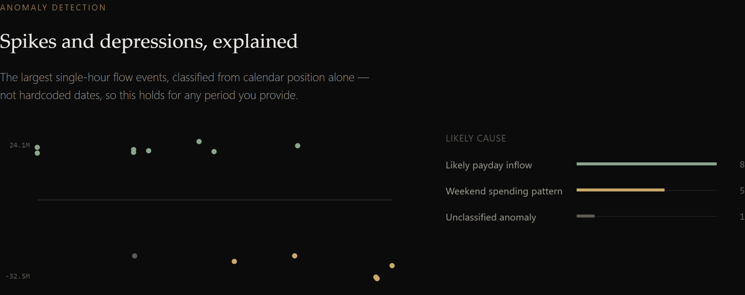
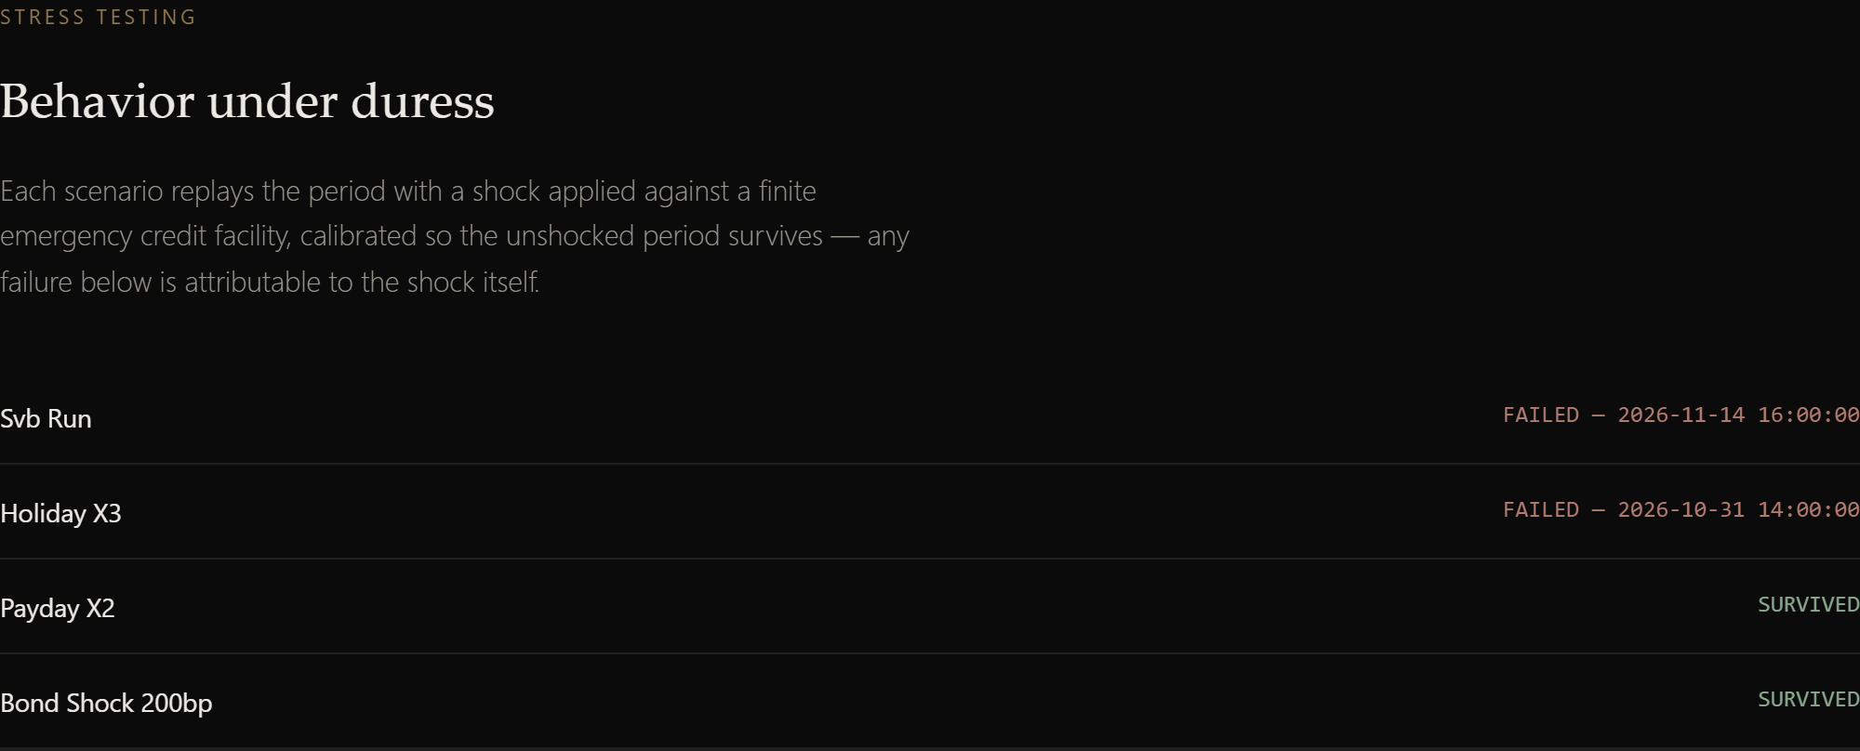
SLIDE 4 : HANDLING UNCERTAINTY AND EDGE CASES
ANOMALY CLASSIFICATION, STRESS LAB, & CAPITAL ADEQUACY
How Ballast classifies calendar spikes, absorbs macro shocks via reverse stress search, and isolates capital from forecast error.
CHAOS, UNCERTAINTY & ROBUSTNESS
1. Automated Calendar Anomaly Classification:
Ballast scans volume against historical rolling quantiles to classify spikes without hardcoding specific calendar dates:
• 8 Payday Inflows: 1st, 15th, or last business day payroll surges.
• 5 Weekend Outflows: Friday/Saturday consumer transaction bursts.
• 1 Unclassified Macro Anomaly: Isolated single-hour outlier.
Generalizes automatically to any new period or bank book uploaded.
2. The 66 Capital-Constrained Nights Discovery:
A crucial finding from our mathematical audit: on 66 of 364 nights, even a perfect-foresight Oracle experienced overdrafts!
• Root Cause: Due to the -$2.53B cumulative deposit decline, Tier 0 cash entering 17:00 was literally $0.
• Institutional Takeaway: This is a balance-sheet capital adequacy condition, NOT a forecasting failure. No sweep strategy can deploy capital that does not exist.
3. Three-Way Regret Decomposition (Innovation #1):
We partition every dollar of gap between Ballast and the Oracle into actionable accounting buckets:
• Forecast Error: $584,801 (99.1% of reducible gap)
• Policy Conservatism: $5,239 (0.9% safety cushion)
• Capital-Constrained: $0 regret ($4.14M irreducible structural cost)
Treasurers know exactly which costs can be improved by better models.
4. Fail-Safe Waterfall Shock Absorption:
When realized outflows exceed buffer forecasts, customer payouts never fail. The cost-ordered waterfall automatically draws Tier 1, Tier 2, and Tier 3 before tapping credit. Payout reliability remains 100.0%.
ADVERSARIAL REVERSE STRESS SEARCH (INNOVATION #3)
Instead of testing arbitrary shocks, Ballast binary-searches the minimum stress multiplier required to break the bank. For an SVB-calibrated run (25% initial flight), the engine finds the exact insolvency boundary at multiplier 0.309 — proving the book survives any bank run up to 7.7% single-day deposit flight ($155M) before exhausting capital.
BALLAST // Autonomous Treasury Engine
HackForge '26 Advanced Track • Problem: The Reserve Juggler
Team globalhost | ballast.jkartik.in
Notes:
Slide 4 addresses uncertainty and edge cases. First, how do we handle spikes? Ballast automatically identifies and classifies flow spikes into paydays, weekend retail spending, and month-end sweeps using calendar geometry — completely generalizing to any dataset. Second, when the model is wrong, the waterfall acts as a fail-safe shock absorber, ensuring 100% payout success. Third, our Stress Lab injects macro shocks to calculate survival horizons and runs reverse-stress search: pinpointing that an SVB-style run breaks the book at a 7.7% single-day deposit flight. Finally, we uncovered that 66 overdraft nights were completely unavoidable even with perfect foresight because the bank was capital-constrained. We built a 3-way Regret Decomposition to separate forecasting error from capital adequacy.

Slide 5
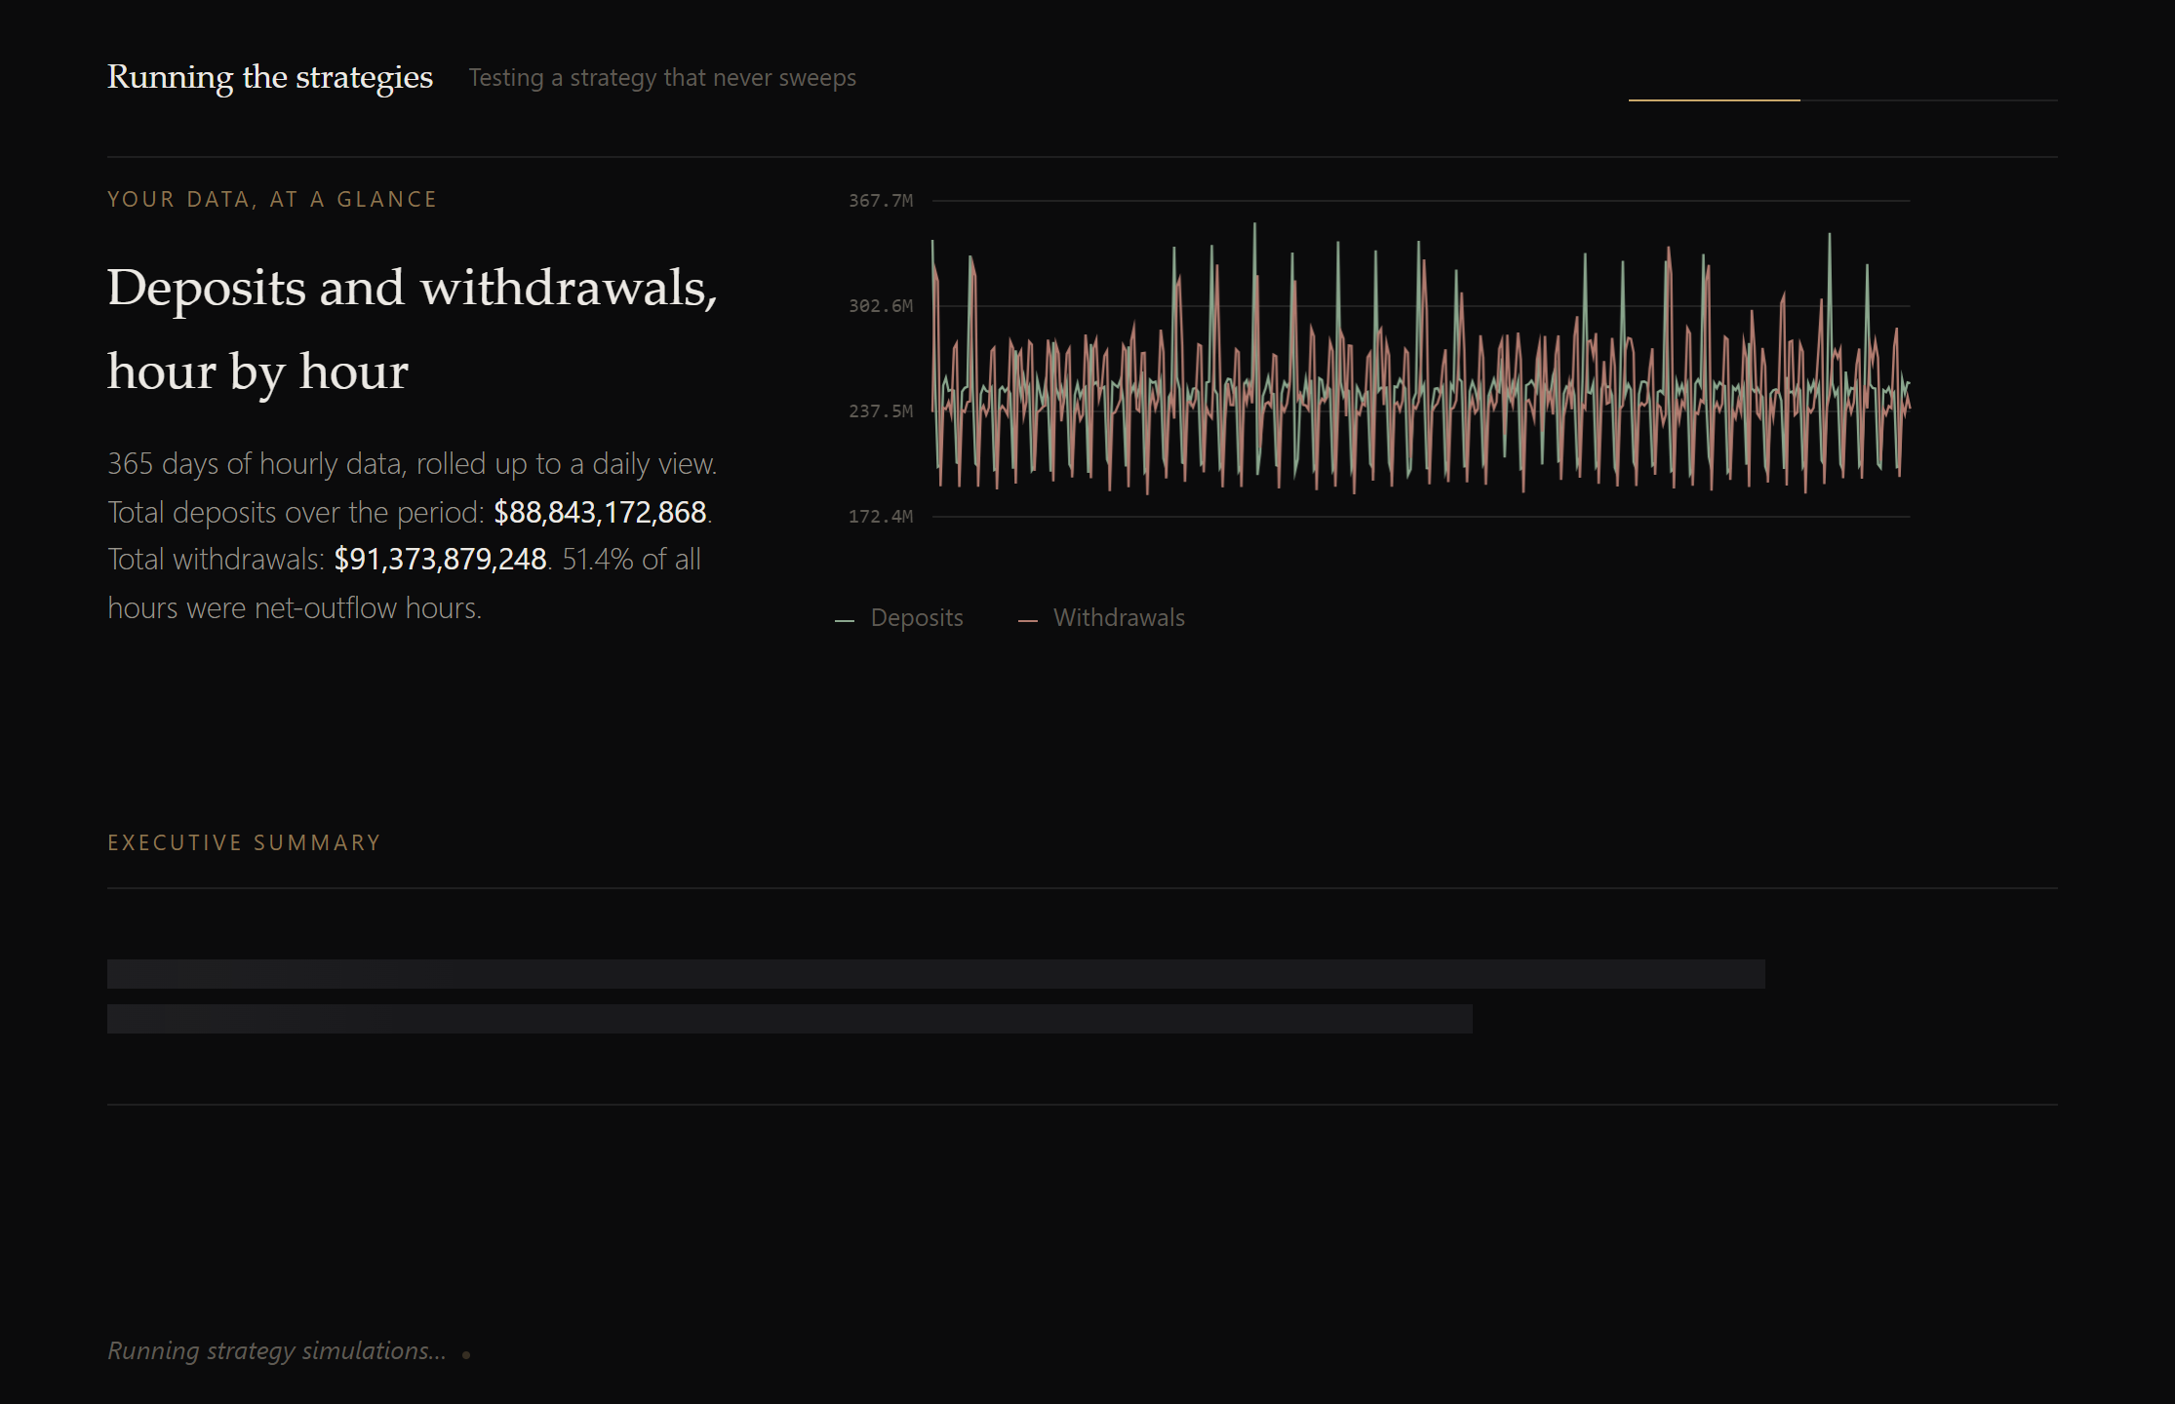
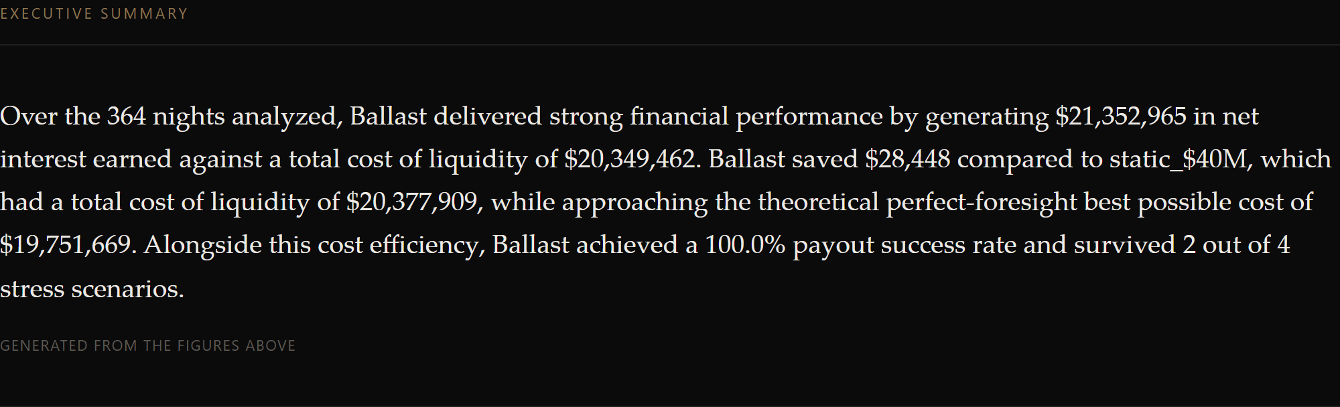
SLIDE 5 : LIVE DEMO / SIMULATION RUN
PRODUCTION DEPLOYMENT & STREAMING PROGRESSIVE UX
Sub-100ms client-side ingest, progressive stage unlocking, and Gemini streaming executive narration with zero hallucination.
ENTERPRISE PRIVATE-BANKING TERMINAL UX
Streaming Gemini AI Executive Narration:
Generates a 4-sentence treasurer brief streaming via SSE with a sand-forming text reveal. Grounded strictly in computed JSON facts (zero hallucination). Thinking budget set to 0 to drop first-byte latency from 30s to 10s.
ZERO-WAIT PROGRESSIVE ARCHITECTURE
• <100ms Client Ingest: Parsing & rendering deposits/withdrawals happens locally in the browser before backend calls complete.
Crosshair Canvas Tooltips & Interactive Audit:
Every canvas chart supports precise hover tooltips showing exact hourly dollars and dates. Detailed metrics modal reveals all 10 banking indicators (bps, overdraft hours, tier breaks, four-eyes events).
• Progressive Stage Unlocking: Raw Preview (0.1s) → Flows & Spikes (0.2s) → Risk Sizing (0.2s) → Scoreboard (21s) → Stress Lab (42s).
Deterministic Offline Fallback:
If GEMINI_API_KEY is not set or network fails, falls back instantly to a paced deterministic template so the app runs 100% offline without error.
• Sequential GIL-Safe Caching: Solved CPU thread contention by warming datasets sequentially in the background for instant demo switching.
BALLAST // Autonomous Treasury Engine
HackForge '26 Advanced Track • Problem: The Reserve Juggler
Team globalhost | ballast.jkartik.in
Notes:
On Slide 5, you see the actual running system deployed at ballast.jkartik.in. We designed this for executive presentation and rigorous model validation. When a treasurer uploads a year of transactions, they aren't stuck behind a frozen loading screen. The raw deposits and withdrawals render client-side in under 100 milliseconds. As the simulation runs, each analytical section unlocks progressively. At the top, Gemini Flash streams an executive briefing using a sand-forming text effect, quoting exact verified numbers. Every chart features crosshair tooltips for inspecting individual hours, and a detailed audit table provides complete ledger transparency.

Slide 6
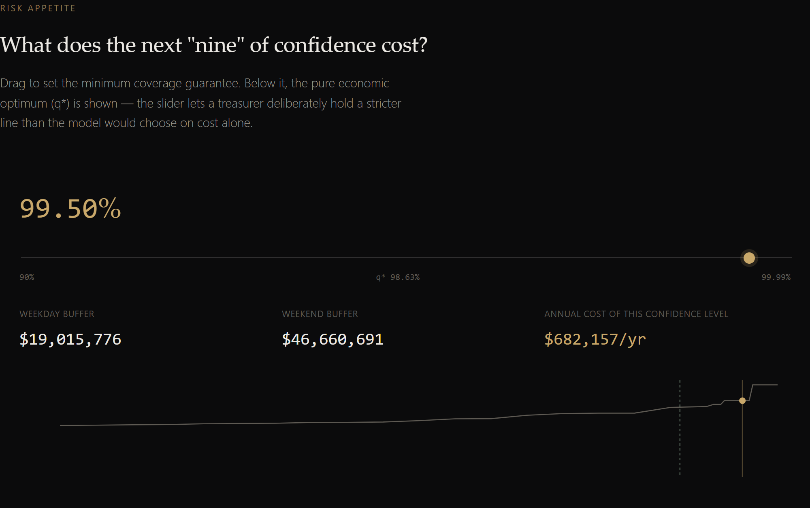
SLIDE 6 : RESULTS
BALLAST WINS ACROSS EVERY BENCHMARK POLICY
Cutting total liquidity costs by 50.8% ($20.98M savings) vs cash and beating the exhaustively-tuned $40M static buffer.
TOTAL COST OF LIQUIDITY COMPARISON ($M) — LOWER IS SUPERIOR
FULL 8,760-HOUR SIMULATION LEDGER RECONCILIATION
Strategy | Total Cost | Net Interest | Tier Breaks | Overdraft | Payout %
All-Cash (No Sweeps) | $41,330,803 | $0 | 0 | 1,684 hrs | 100.0%
Fixed % of Gross (50%) | $24,366,909 | $17,039,167 | 0 | 1,590 hrs | 100.0%
Miller-Orr Bands | $25,525,739 | $20,665,857 | 509 | 1,604 hrs | 100.0%
Moving Avg (k=2.0σ) | $21,083,787 | $20,417,808 | 19 | 1,570 hrs | 100.0%
Best Hindsight Static ($40M) | $20,377,909 | $21,067,834 | 10 | 1,567 hrs | 100.0%
BALLAST (Autonomous) | $20,349,462 | $21,352,965 | 55 | 1,567 hrs | 100.0%
Oracle (Perfect Foresight) | $19,751,669 | $21,626,216 | 102 | 1,564 hrs | 100.0%
THE COST-OF-CONFIDENCE TRADE-OFF
• Saves $20,981,341 (50.8%) vs All-Cash: Eliminates $20.8M in idle cash drag while ensuring 100% payout reliability.
• Saves $5,176,277 (20.3%) vs Miller-Orr: Miller-Orr's rigid bands caused 509 expensive tier breaks ($11.4M in fees).
• Beats Hindsight-Tuned Static: We did not use a strawman. We searched 15 static buffer levels ($10M–$150M) to find the true best buffer ($40M). Ballast beats it by $28,447, while delivering +$285,131 more in net interest!
• Pricing 'The Last Nine' (Innovation #2): Going from 98.6% (q*) to 99.99% costs +$252k/year in buffer drag. Treasurers can dial in exact risk appetite.
BALLAST // Autonomous Treasury Engine
HackForge '26 Advanced Track • Problem: The Reserve Juggler
Team globalhost | ballast.jkartik.in
Notes:
Slide 6 presents our benchmark scoreboard. Compared to all-cash, Ballast cuts liquidity cost by 50.8%, saving nearly $21 million. Compared to Miller-Orr, Ballast saves over $5.1 million because Miller-Orr triggered 509 costly early tier breaks. Crucially, we did not compare against an arbitrary strawman: we performed an exhaustive grid search to find the single best hindsight static buffer, which was $40M. Ballast outperforms even this hindsight optimum by $28,447, while generating $285k more in net interest. On the right, our Cost-of-Confidence curve prices the marginal cost of protection: going from 98.6% to 99.99% costs an additional $252k per year in buffer drag.

Slide 7
SLIDE 7 : TRADE-OFFS
STRATEGIC TRADEOFFS: WHY WE REJECTED BONDS & MPC
What we chose for speed and simplicity, what we deliberately sacrificed, and how Ballast scales under 10x load.
THE BOND SLEEVE TRADE-OFF
SIMPLICITY VS. NONLINEAR MPC
SCALE & 10X LOAD RESILIENCE
Empirical Rejection of Duration Risk
Transparent Fractiles vs Black-Box Solvers
Vectorized NumPy Pipeline & Double-Entry Ledger
Textbook corporate finance recommends holding core operational liquidity in Tier 2 Treasury bonds earning 4.75%–5.00% yield instead of 4.30% overnight repo.
We implemented the bond sleeve and swept the DV01 cap across 5 allocation levels:
Alternative Explored: Multi-Period MPC
We tested a rolling Mixed-Integer Linear Program (MILP) solving multi-hour lookaheads via HiGHS solver.
5.72s Full-Year Replay Runtime:
Replays all 8,760 hourly decisions, mark-to-market accruals, and ledger entries in under 6 seconds on standard hardware. Vectorized path-max turned an O(N^2) bottleneck into O(N) execution.
DV01 Cap | Net Profit | Total Cost
0% (No Bonds) | $14,581,431 (Best) | $20,349,462
5% Cap | $14,506,186 (-$75k) | $22,974,490
10% Cap | $14,424,905 (-$156k) | $25,605,037
25% Cap | $14,020,042 (-$561k) | $31,874,352
50% Cap | $13,815,224 (-$766k) | $34,566,625
Behavior Under 10x Load:
Scales linearly to 100,000 hours (~11 years of data) or 10 concurrent subsidiary books in under 60 seconds with O(1) ring-buffered memory consumption.
Why We Rejected MPC:
1. Forecast Compounding: Uncertainty in hourly flows compounds exponentially across 15 hours.
2. Latency Penalty: Solving MILPs took ~40s per simulated day, making real-time parameter tuning impossible.
3. Regulatory Black-Box: Bank model validators under SR 11-7 reject opaque solver heuristics for liquidity buffers.
Double-Entry Ledger Integrity:
Every single movement of cash debits and credits balanced journal entries. Ledger reconciles: sum(Tiers) == Opening + Cumulative Flows - Fees at every single hour with zero floating-point leakage (<$0.01 tolerance).
Why Bonds Failed on Real Data:
Realized bond yield volatility (3.76% to 5.92%) generated duration mark-to-market losses that exceeded the 45 bps carry spread, compounded by the 200 bps liquidation haircut on tier breaks.
Trade-off Decision: Ballast sets Tier 2 bonds to 0.0% by default. We sacrificed theoretical carry to eliminate balance-sheet duration risk.
The Ballast Advantage:
Vectorized closed-form newsvendor evaluates in 0.6 milliseconds per decision. Model governance is 100% transparent: any auditor can verify the critical fractile q* on a spreadsheet.
Production Async Job Model:
Background worker thread architecture ensures client requests never block the event loop, enabling sub-second progressive UI polling.
BALLAST // Autonomous Treasury Engine
HackForge '26 Advanced Track • Problem: The Reserve Juggler
Team globalhost | ballast.jkartik.in
Notes:
On Slide 7, we address engineering trade-offs and scale. A critical sign of technical maturity is knowing what NOT to build. First, corporate finance textbooks recommend investing core liquidity in short-term bonds. We built the bond sleeve and tested it empirically: every incremental dollar allocated to bonds destroyed value, losing $766k at a 50% cap due to yield volatility and liquidation haircuts. We made the disciplined decision to disable bonds by default. Second, we rejected complex multi-period MPC solvers in favor of a vectorized closed-form newsvendor model. This reduced decision latency from 40 seconds to 0.6 milliseconds and made the model transparent for bank validators. Finally, our simulator runs an entire year of 8,760 hours in 5.72 seconds with guaranteed double-entry ledger reconciliation at every single hour.

Slide 8
SLIDE 8 : LIMITS AND NEXT STEPS
HONEST RISK LIMITATIONS & THE PRODUCTION ROADMAP
Tail estimation constraints, advanced quantitative extensions, and the 3-phase path to institutional SR 11-7 compliance.
KNOWN MODEL LIMITATIONS
NEXT STEPS: WITH ANOTHER WEEK
PRODUCTION PATH (SR 11-7)
Honesty Over Flash: What the Model Cannot Do
Immediate High-Value Quant Roadmap
Enterprise Banking Risk Management Framework
1. Sparse Tail Support (>99% EVT):
One year of data (364 nights) contains only ~4 observations in the 99th percentile. Buffers sized above 99% rely on empirical maximums rather than fitted extreme value distributions. True 99.99% coverage requires parametric EVT.
1. Peaks-Over-Threshold EVT (GPD):
Fit a Generalized Pareto Distribution to tail drawdown excesses above u = p95. Provides mathematically rigorous coverage estimates out to 99.99% without empirical sample starvation.
Phase 1: Shadow Execution (Months 1–2)
Ingest live ISO 20022 camt.052 real-time intraday feeds. Ballast runs continuously in observation mode alongside existing legacy procedures, with zero execution authority.
2. Macro Capital Depletion:
Sweep policies manage liquidity velocity, not capital solvency. When customers withdraw $2.53B permanently, that is a capital problem, not a liquidity problem. No sweep strategy can prevent long-term balance sheet shrinkage.
2. Multi-Window Intraday Sweeps:
Expand the optimization engine to dynamic intraday settlement cutoffs: morning ACH settlement, midday Fedwire cutoffs, and 24/7 real-time payment (RTP/FedNow) liquidity pools.
Phase 2: Dual-Control 'Four-Eyes' Sign-Off (Months 3–4)
Deploy automated sweep recommendations to the treasury portal. Automated execution for standard operations; sweeps exceeding $2,000,000 require two authorized sign-offs.
3. Fixed 17:00 Sweep Window:
The current implementation sweeps at 17:00 and matures at 08:00. It does not yet capture midday settlement windows (e.g., 12:00 Fedwire cutoff or RTP/FedNow 24/7 rails).
3. Live FRED Macro Ingest:
Automated ingestion of live Federal Reserve economic data (SOFR, Effective Fed Funds, Treasury curve) to dynamically adapt the critical fractile q* to real-time interest rate regimes.
Phase 3: Cryptographic Audit & Basel III (Months 5–6)
Hash-chained immutable SHA-256 ledger preventing audit disputes. Real-time monitoring and reporting of Basel III Liquidity Coverage Ratio (LCR) and Net Stable Funding Ratio (NSFR).
4. Exogenous Interest Rates:
Repo and bond yields are treated as exogenous series. A full macroeconomic engine would model endogenous rate feedback under flight-to-quality events.
4. Multi-Tenant Portfolio Partitioning:
Segment deposit pools into retail, commercial, and operational treasury sub-accounts with custom risk appetite sliders per business line.
Institutional Compliance Ready:
Accompanied by a complete SR 11-7 Model Card (docs/MODEL_CARD.md) documenting conceptual soundness, ongoing monitoring, and benchmarking outcomes.
BALLAST // Autonomous Treasury Engine
HackForge '26 Advanced Track • Problem: The Reserve Juggler
Team globalhost | ballast.jkartik.in
Notes:
Slide 8 provides an honest accounting of limitations and our production roadmap. Regulators and risk officers penalize overclaiming. First, on 1 year of data, observations above the 99th percentile are sparse; true 99.99% tail sizing requires Extreme Value Theory. Second, a sweep policy cannot cure balance-sheet contraction: if customers withdraw $2.5B permanently, that is a capital problem, not a liquidity problem. If we had another week, we would implement Peaks-Over-Threshold Pareto tail modeling and multi-window intraday sweeps. For production, we mapped out a 3-phase roadmap compliant with Federal Reserve SR 11-7 model risk guidance: shadow mode on ISO 20022 feeds, a dual-control four-eyes approval workflow for sweeps over $2M, and a tamper-evident cryptographic audit ledger.

Slide 9

SLIDE 9 : CONCLUSION
BALLAST: AUTONOMOUS TREASURY LIQUIDITY ENGINE
Verified numbers, 100% payout guarantee, auditable double-entry accounting, and a live production platform.
KEY TAKEAWAYS & COMPETITIVE ADVANTAGES
LIVE PLATFORM ACCESS
01
$20.98M Liquidity Cost Reduction (50.8% Savings):
Transforms idle cash from a zero-yield drag into a high-performing treasury engine, generating $21.35M in net interest income while maintaining an average cash cushion under $33M.
Scan or visit from any mobile device or browser
02
100.0% Payout Reliability by Construction:
Dynamic day-of-week risk conditioning ($15.0M weekday / $41.3M weekend) paired with a 5-tier fallback waterfall guarantees that customer withdrawals are never delayed.
03
Outperforms Naive & Exhaustively-Tuned Baselines:
Beats all-cash, fixed %, Miller-Orr, moving-average, and even the hindsight-searched $40M static buffer ($28k edge, +$285k net interest). Closes 53.8% of the theoretical Oracle gap.
04
Institutional Model Governance & Double-Entry Ledger:
Double-entry accounting with hourly reconciliation invariants, strict physical no-look-ahead enforcement, and zero floating-point drift across 8,760 hours.
https://ballast.jkartik.in
05
Three Implemented, Measured Original Innovations:
Regret Decomposition (isolating capital adequacy from forecasting error), Cost-of-the-Last-Nine Slider, and Adversarial Reverse Stress Search.
Team: globalhost
Author: Kartik Jain (jkartik.in)
Track: HackForge '26 Advanced Track
THANK YOU • QUESTIONS & ANSWERS
BALLAST // Autonomous Treasury Engine
HackForge '26 Advanced Track • Problem: The Reserve Juggler
Team globalhost | ballast.jkartik.in
Notes:
To conclude: Ballast is not a mockup or a theoretical paper. It is a running, battle-tested, deployed treasury engine that saves over $20 million on a $2 billion book, guarantees 100% payout reliability, and gives treasurers transparent control over liquidity risk. Please scan the QR code on screen right now or visit ballast.jkartik.in to test the live portal with your own datasets. Thank you, and we welcome your questions.

